Slide 1
BUILDING CONNECTION & COMMUNITY

Slide 2
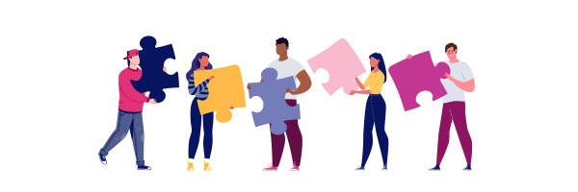
Our Time for Today
A PRIMER FOR EMPATHY
ACTIVITY
INSPO

Slide 3
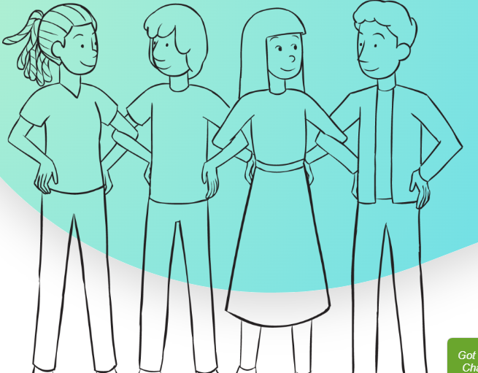
Making Connections
The objective is to create one large circle in which every person is physically linked with two others
Notes:
Having gathered your group, explain that their ultimate objective is to create one large circle in which every person is physically linked with two others, left and right of them.
However, the primary focus of this connections ice breaker game will be on a very different form of connection.
Kick off by asking one person to volunteer by standing with one of his or her hands on their hip, to form the look of a tea-cup handle.
Invite this first brave soul to share one or more statements about themselves which others in the group may (or may not) know. For example, a special prize they may have once earned, a particular travel destination they have visited, or a favourite book, movie or song of theirs.
Encourage the rest of your group to listen carefully, and when someone hears a statement that they have in common, they are invited to link elbows (left elbow to right elbow, to allow people to face the same direction) with the first volunteer.
Next, this second person will share something about themselves to the larger group, and the process repeats itself with a third person linking arms with the second person because they share something in common, and so on.
Continue play until every member of the group has formed a common ‘link’ with another person.
Note, the last person to link to the very long chain of connections will be invited to share one or more statements about themselves which the very first volunteer will necessarily share in common, enabling these two people to link.
One large connected circle has now been formed, and voila, you’re done!

Slide 4
Community Values + Intentions
Everyone is a Teacher. Everyone is a Learner.
Commitment to engaging in the activity and small group discussion
[ add your own ]
Flipped Vegas Rule: What is learned here, leaves here.
Mutual respect, open-mindedness and inclusive language.
Be kind and curious.

Slide 5
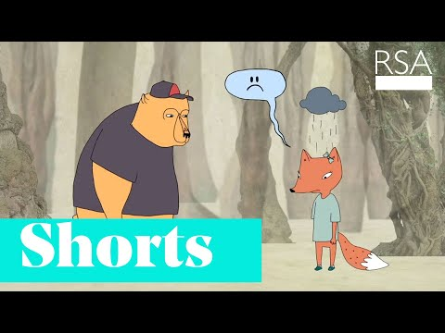
Brené Brown
Connection is why we’re here; it is what gives purpose and meaning to our lives

Slide 7
Poetry Exercise from Beverly Tatum
Using a four-stanza poem structure, use sensory details to describe the many people, places, and things that show us where we are from
Each stanza beings with “I am from . . .“
Aim to have four (4) to five (5) lines per stanza

Slide 9
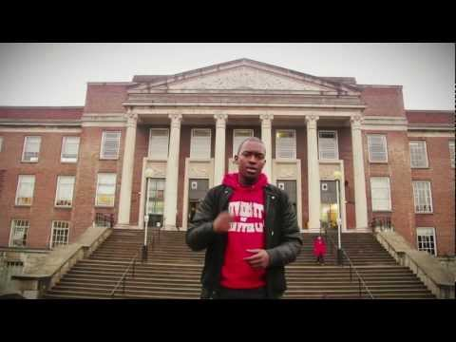
Suli Breaks
Why I Hate School But Love Education

