Slide 1
Leading a Multigenerational Workplace
Leadership Development Program
Colby Brown, M.Ed.

Slide 2
Community Values + Intentions
Everyone is a teacher and a learner
Flipped Vegas Rule
Be kind and curious
Invitation to welcome new perspectives
[ add your own ]

Slide 3
Agenda + Learning Outcomes
1
2
3
Research
Eccles Context
Activity
Understand current state of workplace through literature
Apply transition and career theories to frame or reflect on current approach
Identify own personal histories to construct a poem

Slide 4
Baby Boomers, Generation X, Generation Z, and Millennials . . . oh my!
Be it the wave of Millennials who are beginning to climb the corporate ladder or the Baby Boomers preparing to leave, it is not uncommon to find four generations working within the same business environment — Baby Boomers, Generation X, Millennials and Generation Z.
Each generation comes with its own cultural context, economic background, and personal histories, so requires different management approaches.
Opportunities are present - cultivate them
Notes:
Opportunity to learn from one another, fostering a culture of collaboration, teaching, and understanding. Regardless of the leadership approach that is taken, as the current state of the market and the future continue to include a diverse age group, it’s essential to encourage teams to work together and learn from one other’s experiences, which will allow the business to thrive.
Understanding this multigenerational workforce and its implications will be essential for driving innovation, creating united and productive teams, and adapting to the future workplace

Slide 5
Baby Boomers, Generation X, Generation Z, and Millennials . . . oh my!
Each generation comes with its own cultural context, economic background, and personal histories, so requires different management approaches.
76% enjoy working alongside colleagues of different ages¹
89% of talent professionals agree that multigenerational workforce makes the company more successful²
Opportunities are present - cultivate them
Notes:
Opportunity to learn from one another, fostering a culture of collaboration, teaching, and understanding. Regardless of the leadership approach that is taken, as the current state of the market and the future continue to include a diverse age group, it’s essential to encourage teams to work together and learn from one other’s experiences, which will allow the business to thrive.
Understanding this multigenerational workforce and its implications will be essential for driving innovation, creating united and productive teams, and adapting to the future workplace

Slide 6
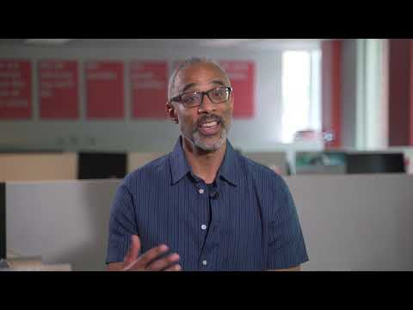
Varying Levels
Wellbeing is based on five elements (career, social, financial, physical and community) that work in tandem to create thriving lives³
Notes:
Gallup finds that higher levels of organizational wellbeing track with lower levels of employee burnout, stress, worry, anxiety and depression -- while boosting trust, innovation and resiliency. Even engaged employees who are not thriving in their wellbeing have a higher risk of burnout.
For example, a recent college graduate, who started their first job during the pandemic and is accustomed to a remote setup, might put a high value on flexible work and prefer to communicate digitally. On the other hand, someone who entered the workforce in 2008, during the Great Recession, might value job security and routine, and prefer to work a predictable nine-to-five schedule, five days a week.

Slide 7
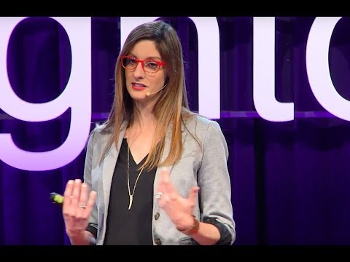
Meet People In Their “Onlyness"
Doesn’t require to unpack and live there with them

Slide 8
Honing in on the University of Utah
Students
BCS
Partners
Employers
Notes:
When creating an intentional onboarding experience for new employees, you may find a few transition and career theories valuable to frame or reflect on your approach. Your new hire may express a variety of emotions or thoughts at different points in their time working with you.

Slide 9
Theory to Practice
Adult Transition Theory
Much like supporting college students with moving in, moving through, and moving out of a transition, Nancy Schlossberg’s life work and research around adult transitions can help us and others when navigating transitions
Happenstance Learning Theory
Ensuring supervisors and employees are open to taking advantage of unexpected or unplanned opportunities to learn, engage, and reflect will yield positive career outcomes
Integrated Life Planning Theory
Instead of separating out roles or one’s personal and work life, acknowledge the complexities of life and how different elements of life impact others

Slide 10
Principles for Supporting Generations
Initiate (genuine) conversations
Ask about needs and preferences
Offer Options (e.g. hybrid environment)
Personalize your leadership style
Build on strengths
Go beyond tolerance + work on projects together
Opportunities are present - cultivate them

Slide 11
I AM FROM . . .
A
B
C
D
Specific sights, sounds, and smells from your home and neighborhood
Specific foods, especially those associated with special occasions
A
B
C
D
Specific sayings or phrases heard growing up
Specific people who influenced your life

Slide 12
Strength lies in differences, not similarities
1
2
3
4
Accept differences
View generational diversity as an advantage
Create a culture of accountability
Avoid generational stereotypes

Slide 13
Thank You

Slide 14
Resources
https://newsroom.ricoh-usa.com/2019-05-15-New-Ricoh-research-finds-generational-divide-in-the-workplace-to-be-a-myth
https://www.getsmarter.com/blog/market-trends/the-future-of-work-changing-values-in-a-multi-generational-workforce/
https://www.gallup.com/workplace/389036/leaders-focus-2022.aspx
https://youtu.be/dpAT2Dfg2vU
https://youtu.be/kzfAOc4L6vQ
https://www.clemson.edu/studentaffairs/sabo/human-resources/documents/department-onboarding-resources.pdf
https://assets.aarp.org/www.aarp.org_/articles/money/employers/leading_multigenerational_workforce.pdf
http://johnsonclasswebsite.weebly.com/uploads/5/6/3/4/56345927/i_am_from_poem_format_with_example.pdf

